Slide 1
Cloud Native Architectures & Security
April 2018
Notes:
Cloud native applications, and bringing microservice architectures into production in the enterprise.

Slide 2
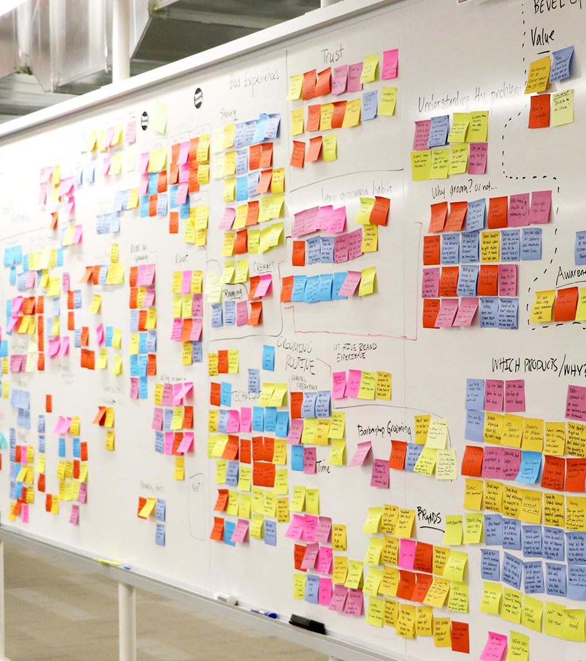
Agenda
What are Cloud-Native Applications?
Why Cloud-Native Applications Matter?
Characteristics of a Cloud-Native Organization
Cloud-Native Architecture

Slide 3
WHY?

Slide 4





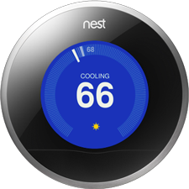
Software is changing industries

Slide 5
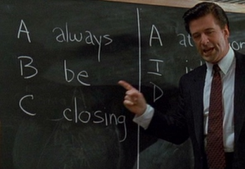
Cloud-era Demands
Competitive landscape
Consumer expectations
Device Diversity and Ubiquity
Scale
D
delivering
5

Slide 6
Cloud Computing
Being Reactive
Speed & Safety
React to Events
React to Load
React to Failure
React to Users
Design for quick recovery
Quick recovery increases risk tolerance
Risk tolerance enables innovation
6

Slide 7
WHAT?

Slide 8

CLOUD NATIVE
Agile
Lean
Continuous
Delivery
Microservices
Cloud
DevOps

Slide 9
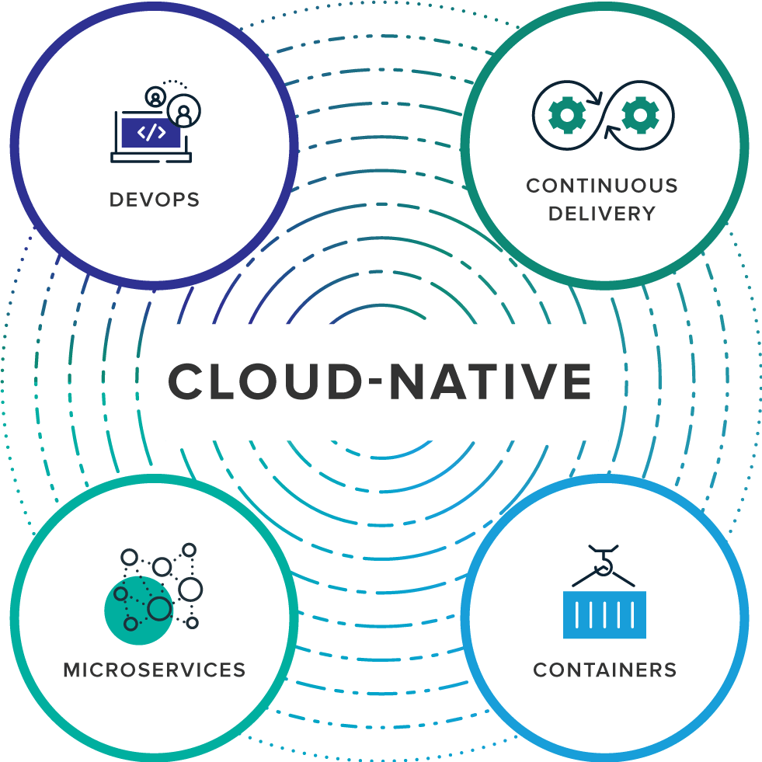
What are Cloud-Native Applications?
collaboration between software developers and IT operations with the goal of constantly delivering high-quality software that solves customer challenges
enabled by Agile product development practices, is all about shipping small batches of software to production constantly, through automation
an architectural approach to developing an application as a collection of small services; each service implements business capabilities, runs in its own process and communicates via HTTP APIs or messaging
offers both efficiency and speed compared with standard virtual machines (VMs)
9

Slide 10
Cloud-Native Versus Traditional Enterprise Applications
CLOUD-NATIVE APPS
Predictable
OS Abstraction
Right-size capacity
Collaboration
Continuous Delivery
Independent
Automated Scalability
Rapid Recovery
TRADITIONAL ENTERPRISE APPS
Unpredictable
OS Dependent
Over-sized Capacity
Siloed
Waterfall Development
Dependent
Manual Scaling
Slow recovery
10

Slide 11
Characteristics of Cloud Native Architecture
Continuously Delivered
Twelve Factor Apps (http://12factor.net/)
Microservices
Self-Service agile infrastructure
API-based collaboration
Anti-fragility

Slide 12
Enabling Continuous Delivery
Development
Operations
Idea
Business
Customer
$
Value
QA
Companies that disrupt, reduce time to value

Slide 13
Enabling Agile Delivery
Behavior Analytics
Design
Development
Customer Feedback
Test
Customer Delivery

Slide 14
Enabling Continuous Delivery
Production Release
ORDERS
Production Release
Production Release
SHIPPING
Production Release

Slide 15
Twelve-Factor Apps
Codebase
Dependencies
Configuration
Backing Services
Build, release, run
Processes
Port binding
Concurrency
Disposability
Dev/prod parity
Logs
Admin processes
APPS
contract
Cloud Platform
Architectural and development practices – http://12factor.net

Slide 16
Microservice: Definition
If every service has to be updated in concert, it’s not loosely coupled!
“ Loosely coupled service oriented architecture with bounded contexts"
If you have to know about surrounding services you don’t have a bounded context.
- Adrian Cockcroft

Slide 17
Microservices are NOT
Monolithic Application
Service
Service
HTML
JavaScript
MVC
Enterprise Service Bus
Service
Service
OR
Data Access
Service
Service
Tightly Coupled
- Adrian Cockcroft
Centralized

Slide 18







Microservices Architecture
Relational
DB
HTTP
HTTP
Key/Value
Store
HTTP
HTTP
HTTP
AMQP
…
AMQP
HTTP
Graph
DB

Slide 19
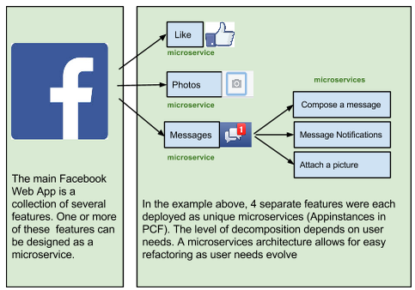
A familiar Microservice example

Slide 20
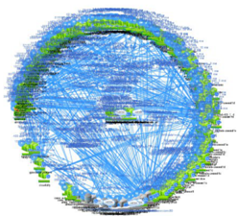
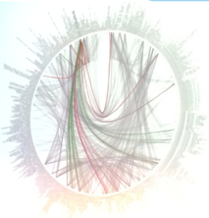


Microservices are hard

Slide 21
Challenges of distributed systems
Configuration Management
Service Registration & Discovery
Routing & Load Balancing
Fault Tolerance (Circuit Breakers)
Monitoring
Concurrent API Aggregation & Transformation

Slide 22
HOW?

Slide 23
It takes a Cloud Native Application Framework
Spring
#1 Enterprise Java App Framework
Netflix
Open Source
Spring Boot
Quick Start
Little to no config.
Opinionated View
Spring Cloud
Distributed Config
Service Registration and Discovery
Fault Tolerance
Routing/Load Balancing
Service Integration
Pivotal is the main custodian of Spring and we hire the main committers for Spring Boot and Spring Cloud. We can bring these resources to bear to help significantly accelerate a customer’s journey to becoming a Cloud Native enterprise

Slide 24
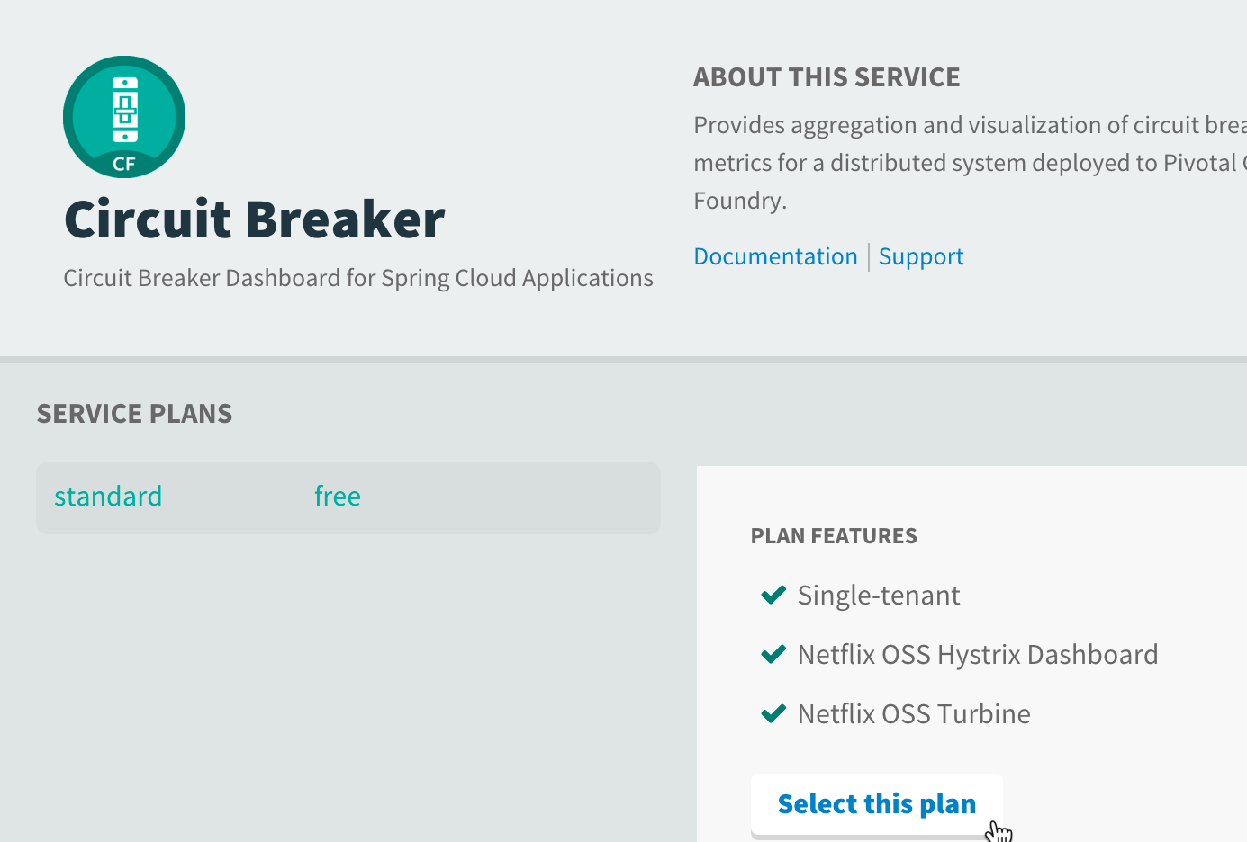
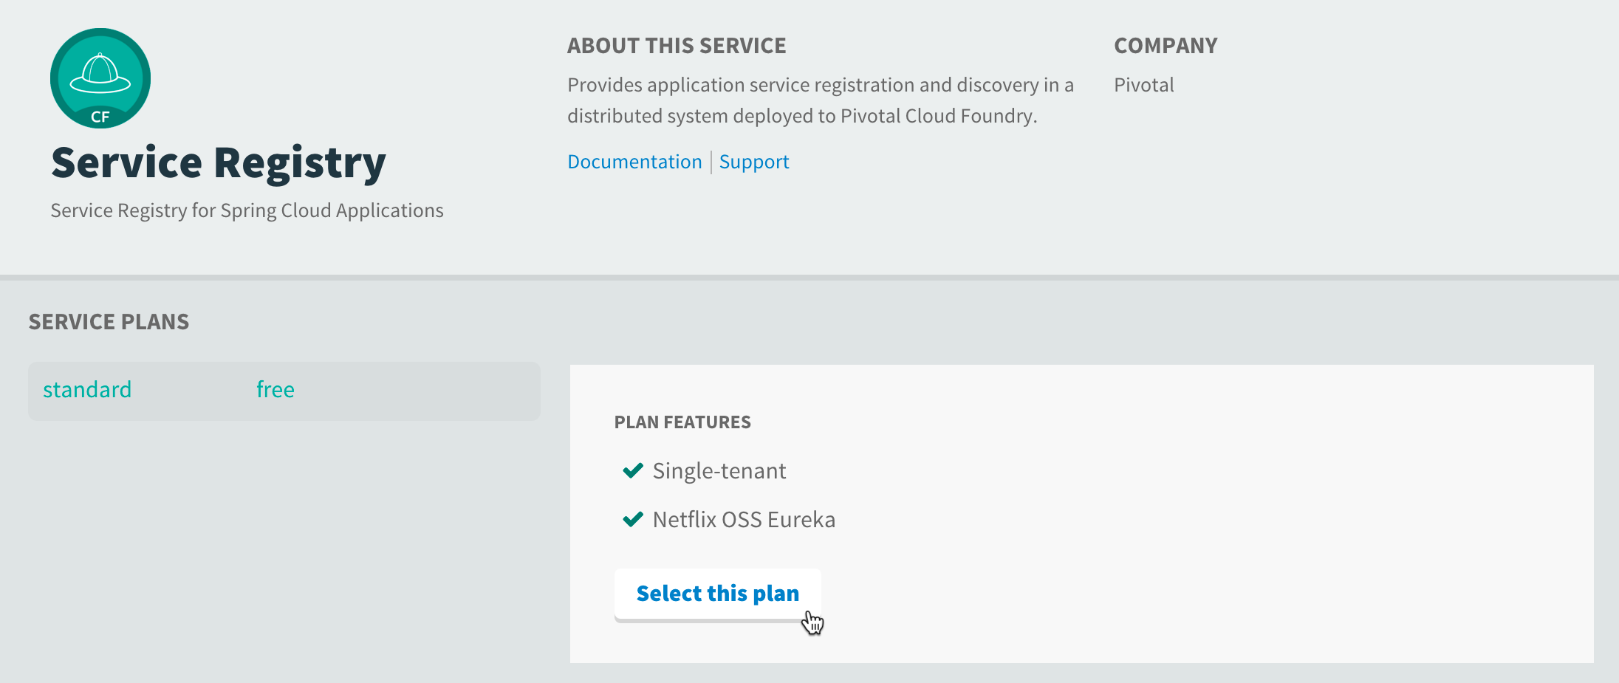

Spring Cloud Application coordination patterns
Runtimes and their client libraries for:
Configuration Management
Service Discovery
Routing & Load Balancing
Circuit Breakers
Reverse Proxies
….and much more
Security (encrypt, SSO, roles)
Connectors for CF, Heroku, AWS

Slide 25

Companies want to be fast like Netflix
Netflix needed to be faster to win / disrupt
Pioneer & vocal proponent of microservices - the key to their speed and success
Netflix OSS supplies parts, but it’s not a solution
Difficult for enterprises to build it themselves
Pivotal offers the closest thing to “Netflix in a box” today
“
“Velocity on the JVM is the Killer App”
- Andy Glover (Netflix Eng) @ SpringOne2GX 2014 Keynote
https://youtu.be/xU267-YHN5c?t=1938

Slide 26
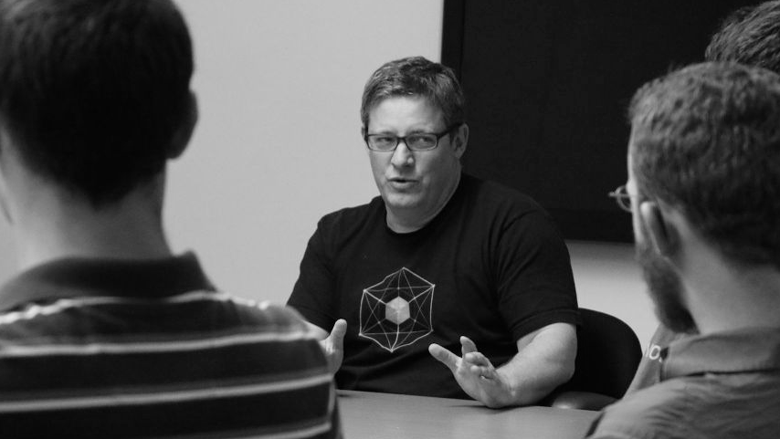
It takes a Cloud Native Platform
An end-to-end platform that makes implementing distributed application best practices, a turn-key and first practice

Slide 27

Essential elements of a Cloud-Native Platform
Rapid Provisioning of infrastructure components
Rapid Application Deployment & Management
Scales Horizontally
Basic Monitoring, Logs & Metrics
No-downtime platform upgrades
Dynamic load balancing and routing
Manage supporting services (data, messaging)
Failure detection and health remediation

Slide 28


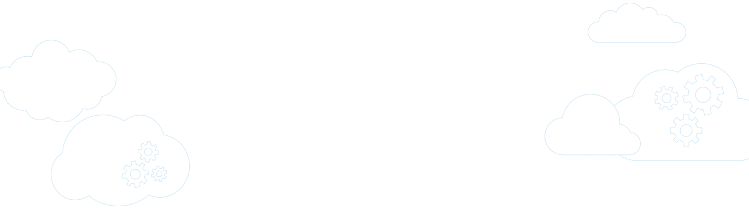
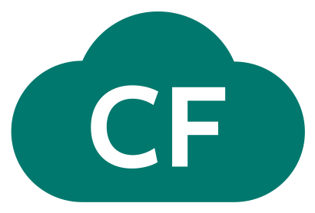
Pivotal Cloud Foundry
A complete framework for delivering software rapidly, consistently and reliably at scale.
Language frameworks designed for microservice architectures with components for service discovery, metrics, circuit breakers and more.
Application Framework
Application container runtime with production-ready backing services, automated build pipeline, routing, health management and logging.
Platform Runtime
Pivotal
Cloud Foundry
API-based infrastructure provisioning that delivers bit-for-bit, consistent, self-healing deployments across private and public cloud.
Infrastructure Automation
Pivotal
Cloud Foundry

Slide 29



Cloud Foundry Haiku
Here is my source code
Run it on the cloud for me
I do not care how

Slide 30
Bosh Haiku
Here are my servers
Go make them a cloud foundry
I do not care how

Slide 31
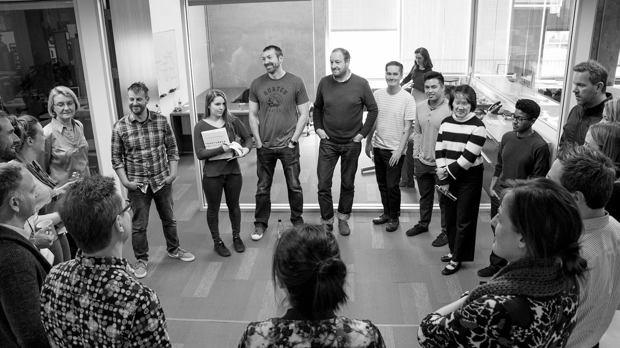
Transforming How The World Builds Software
© Copyright 2018 Pivotal Software, Inc. All rights Reserved.

